Slide 1

Concevez une application au service de la santé publique
Ali JAFFAR
05/06/2021

Slide 2
Fast Food Infographics
Data Analysis
Data Selection
Pre-treatment
Cleaning, Imputation, KNN , KNN Imputer and arbitration
Graph après le nettoyage Univariable, Univariable, Multivariable
01
02
03
Automation
Knap Sack
statistical test
Pearson. ANOVA, PCA et Chi2 test
06
05
04

Slide 3
Problematique
Un notebook du nettoyage des données (non cleané, pour comprendre votre démarche).
Un notebook d’exploration comportant une analyse univariée, multivariée, une réduction dimensionnelle, ainsi que les différentes questions de recherches associées (non cleané, pour comprendre votre démarche).
Une présentation, à utiliser en support pour la soutenance, comprenant :
La présentation de votre idée d’application.
Les opérations de nettoyage effectuées.
La description et l'analyse univariée des différentes variables importantes avec les visualisations associées.
L’analyse multivariée et les résultats statistiques associés, en lien avec votre idée d’application.
3 observations solidement étayées (graphes et/ou tests statistiques à l’appui au besoin) évaluant la pertinence et la faisabilité de votre application.
La synthèse des différentes conclusions sur la faisabilité de votre projet.

Slide 4
Description des Donnees
Description of the DATA
Les columns represented the information of each products from the description to details of the products from composition, manufacturing , nutritional values and others
The rows represent the numbers of product registered

Slide 5
01
DATA
Data Analysis
Data Selection

Slide 6
Seeing Missing Data
Package: msno
This helps us see the correlation of missing data between columns.
It’s hard to know what to do with null values in our data. Most times, it’s easier to drop them and follow with what’s left.
But they can eventually have meaning and can be investigated. Taking some time to have a good look at them can often bring a better understanding of how the data was collected and even reveal some patterns in it.

Slide 7
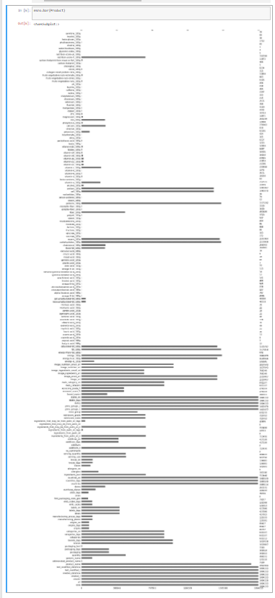
Existing Valuables
Selection determining by nutri score
This bar chart represents the number of records in each column. Here we have two scales, one telling the exact amount of values in the field (right) and the other representing the proportion to the total number of rows.
Starting with a bar chart allows us to quickly tell if we’ll need to spend more time analyzing the null values or not.
In this case we have selection 2 types of variables
Variable of interest :
relevant variable :
Les variable d'intérêt et pertinente :
Products = Product[[ 'nutriscore_score' ,'nutriscore_grade','energy-kcal_100g', 'energy_100g', 'fat_100g', 'saturated-fat_100g',
'carbohydrates_100g', 'sugars_100g', 'fiber_100g', 'proteins_100g',
'salt_100g', 'sodium_100g',"cholesterol_100g","potassium_100g","countries_en"]]

Slide 8
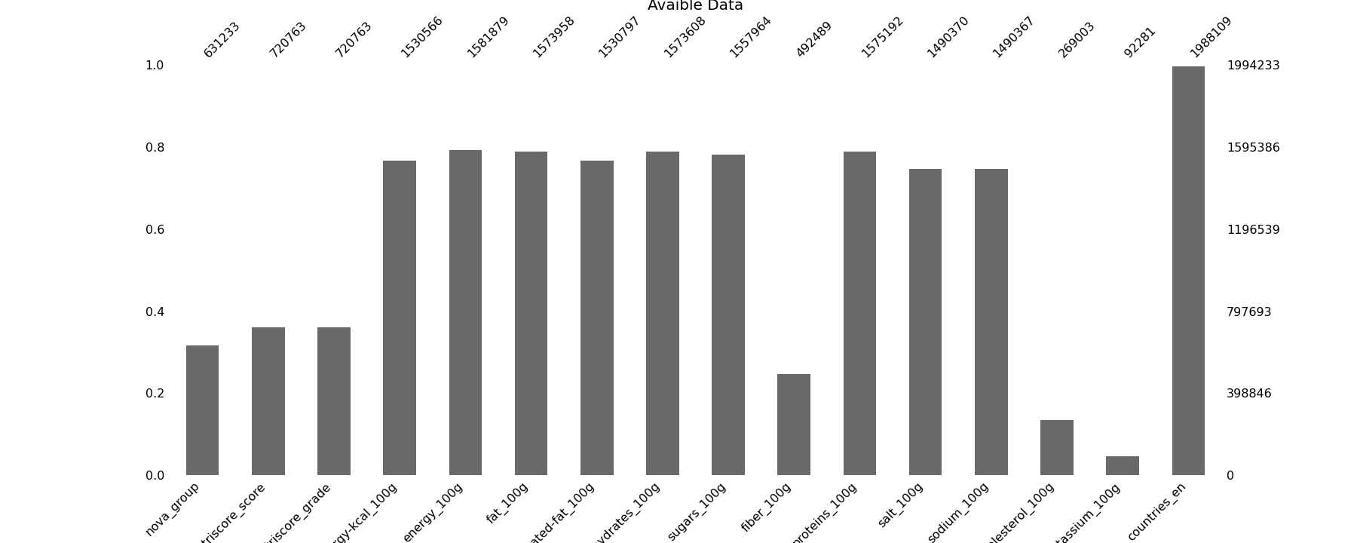
Our Selection
What we see
After selecting our columns we are going to analyse and invest time on it . We need wish columns we can fill with formulas and KNN and other means and which we would need to Remove.

Slide 9
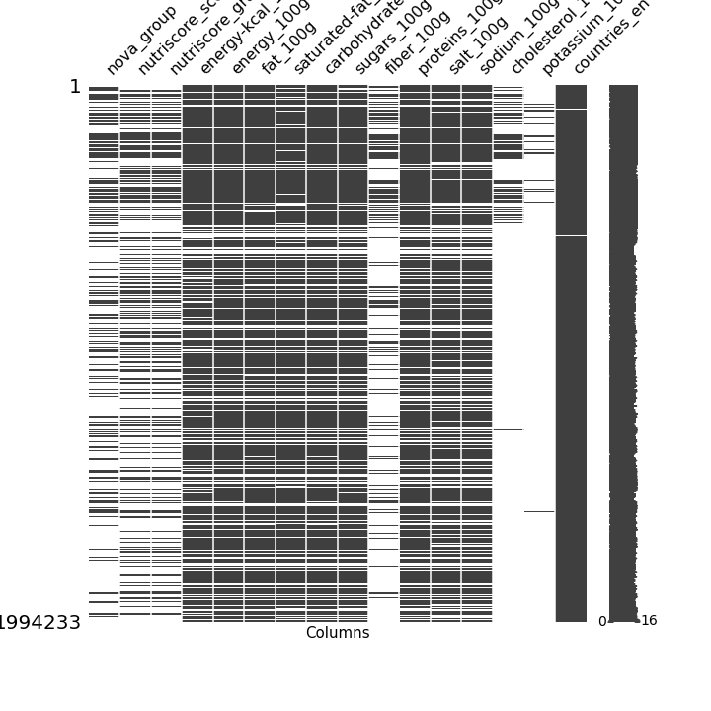
Notres Selection
What we see
A matrix tells us exactly where the missing values are, in our example, the data is sorted with the newest records on top.
We can already have some valuable insights by looking at the matrix and knowing how our data is arranged. Here we can see that the data collected changed at some point, where fields such as cholesterol , potassium and fiber are light compare to the other. But we do know that fiber is part of NOVA, the Carbohydrate and Potassium is a relevant component of the weight of the product. Knowing well that Fiber is a component that is hard because there’s not known formula to find it, to fil, as well for Potassium. In such we do need KNN to impute the data.

Slide 10
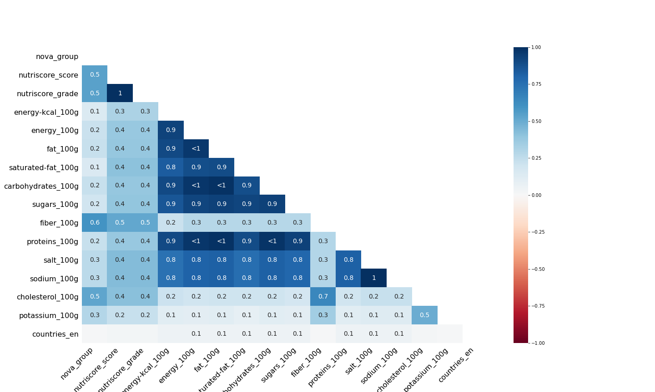
Correlation of missing data
What we see
This plot represents the correlation between the null values by column.
Column A has a value, B also has a value, which means a strong positive correlation or a blue 1 in the chart.
Column A has a value, but B has a null, which means a strong negative correlation, or a red -1 in the chart.
We noticed earlier that there was some change in the way data was collected, and here we can see it again. The new variables have a positive correlation with themselves
Even though we can visualize that relationship by looking at the matrix, heatmaps make them more evident. It’s not always that we’ll have our rows sorted in a convenient way for us to realize the pattern.
In this dataset, we can see that the fields of the survey are almost grouped.
So, if one question is answered, we’ll very likely have the answers for all items of that group.

Slide 11
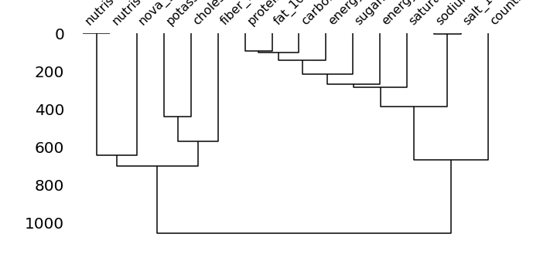
Correlation of missing data
What we see
We saw some group behaviour with the heatmaps, but primarily because of the dataset arrangement.
If the rows are sorted, we can notice some correlation between the fields using the matrix chart, but this would be harder if they’re randomly positioned.
The same thing goes with heatmaps. If the columns are randomly positioned, we would have a more challenging time figuring out the pattern among groups of variables.
The dendrogram uses a hierarchical clustering algorithm to bin the fields by their correlation. *the relationship we saw with the heatmaps.
So it’s like figuring out which fields are highly related to each other in matters of nullity, then testing how those groups of variables relate to themselves and so on. From here we do see that Nova is correlated to Nutri grade and Nutriscore in a way. And

Slide 12
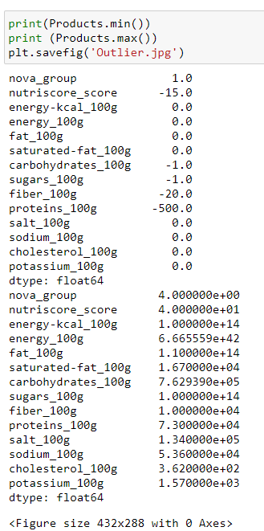
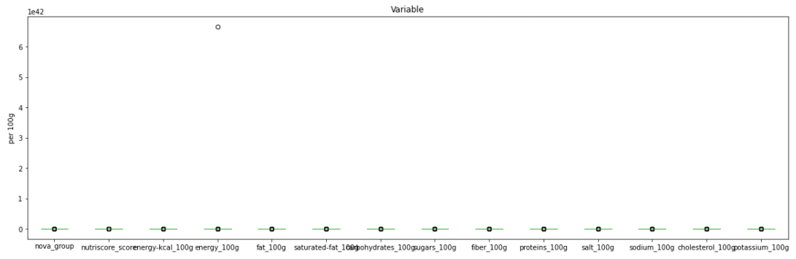
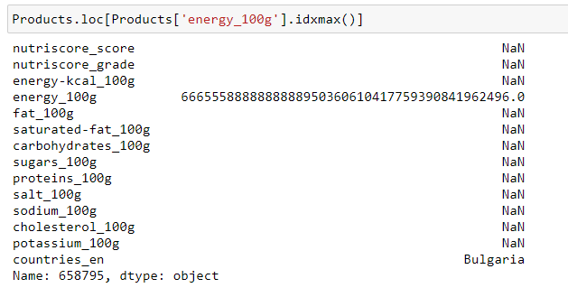
Outliers

Slide 13
Outliers
What we see
As we look at the data in a new light “ Box Plot “ we see that they are outliers that are affecting the core of the Data and will also affect the work we will be having. Before we even start our work. We do need to:
Find a way to recover the rows with outlier.
Use arbitrary functions to remove the Outliers

Slide 14
02
Pre-treatment
Cleaning, Imputating, KNN , KNN Imputer and arbitration

Slide 15


Data preprocessing process
 | Mean | Inserting the Mean for Fiber,additives_n,fat_100g,carbohydrates_100g and sodium_100g based on the average of each grade separately
 | Cleaning See page 16 | Removed 100% empty lines Remove duplicates | Data removed 332.265 372.332
 | Recovery See page 17 - 18 | Imputation formulas to fill in the NAN Create Virtual columns to replace exaggerated data (explain in detail and graph): Protein, Energy, NutriScore
 | Arbitration See page 19 | Putting arbitration to remove any data with outliers | Data removed 510104

Slide 16
Cleaning
 | Removing rows that are 90% empty | perc = 90 # Here N is 100 min_count = int(((100-perc)/100)*df.shape[1] + 1) df = df.dropna( axis=0, thresh=min_count) df | Shape (1661968, 16)
 | Removing duplicate | Products= Products.drop_duplicates() Products | (1289636, 16)
 |  | Those data are impossible to recover because we don’t have enough information to work with and the duplicate are useless to have them twice

Slide 17
Recovery: imputation formula
Recovery is based on formulas that can be found online and that are used to fill data that are easily imputated. We use the lambda function to see if the data is missing we will use the formula to input it, otherwise we leave it alone.
Formula:
Products['fat_100g'] = Products.apply(
lambda row: ((row['energy_100g']- (row['proteins_100g']*17) - (row['carbohydrates_100g']*17)) /37 )
if np.isnan(row['fat_100g'])
else row['fat_100g'], axis=1)
Each columns has a specific formula that will be used to fill the data such as:
Energy = 'carbohydrates_100g x 17 + proteins_100g x 17 + 'fat_100g x 37
Calories = Energy / 4.184
sodium_100g= salt/2.5
Potassium = 100 g- fat_100g - proteins_100g -carbohydrates_100g- sodium_100g- 'cholesterol_100g

Slide 18
Recovery: Create Virtual Columns
The creation of those extra columns do help us to see the difference of the current data in a columns and compare it to the virtual one we have created that is based on the same formula we have build previously.
These columns will help us to correct some outliers with data that are not in the acceptable range of a standard product
Standard product
Max calories: 900
Max weight: 100g
Max sodium: 40g = 100g salt Max energy = 3780

Slide 19
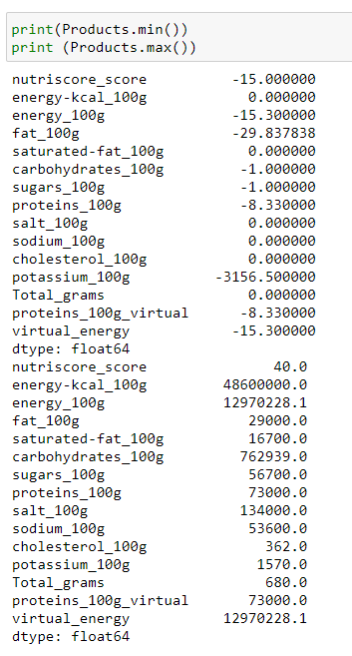
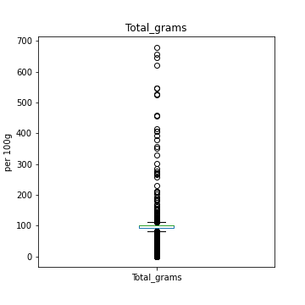
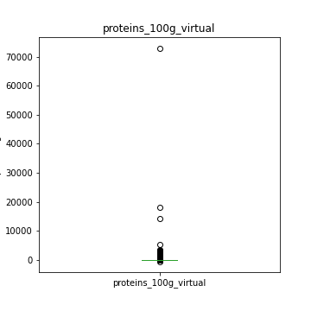
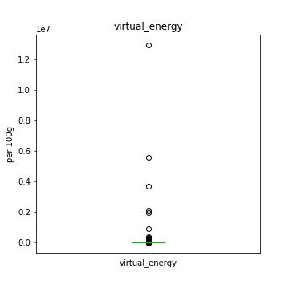
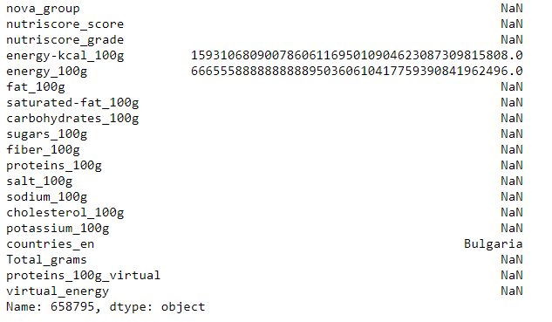
Arbitration

Slide 20
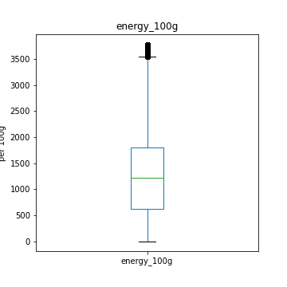
Arbitration
As you can see here the outlier as above the standards.
the Total_Gram : is the total Grams a product can contain in a 100g . the product mustn’t surpasse 100g or even below 0. We are still assuming that most data wasn’t filled and the virtual data wouldn’t be always at 100g. As you can clearly see that some products arrive to 700g in a 100g container.
Same situation for the protein that reach over 73.000 even thought the maximum is 100
Same situation with the energy, and the rest
By putting arbitration based on the standard product we will be able to remove any outliers that we weren’t able to fix.
By doing this we have lost another 510. 104 shape(779532, 19)
Before cleaning
After Cleaning

Slide 21
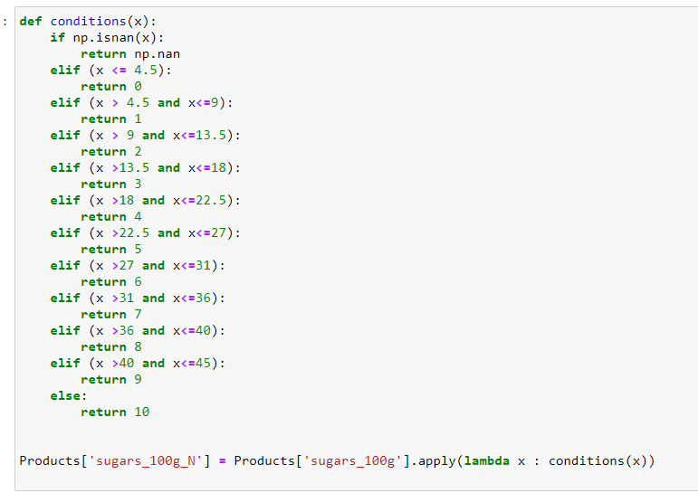
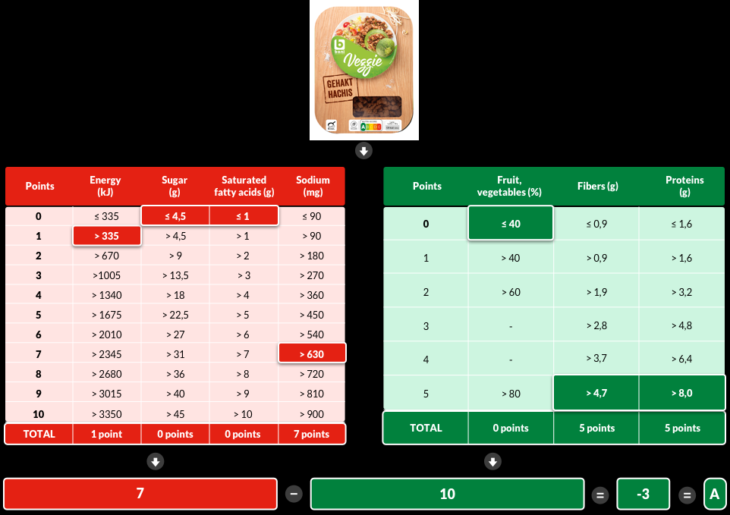
Recovery: Create Virtual Columns Nutriscore
After imputation most of the data . we are now able to use a formula from the Nutriscore to calculate each columns value that it will provide to the Nutriscore.

Slide 22
Recovery: Nutriscore and Nutrigrade imputing
def nutri_score(e,su,so,sa,po):
if((np.isnan(e)) or (np.isnan(su)) or (np.isnan(so)) or (np.isnan(sa)) or (np.isnan(po))):
return np.nan
else:
return (e + su +so+sa-po-2)
Products['nutriscore_score'] = Products.apply(lambda row :nutri_score(row['energy_100g_N'] , row['sugars_100g_N'] ,
row['sodium_100g_N'] , row['saturated-fat_100g_N'] , row['proteins_100g_N']),axis = 1)
conditions = [
(Products['nutriscore_score'].isna()),
(Products['nutriscore_score'] <= -1),
(Products['nutriscore_score'] >= 0) & (Products['nutriscore_score'] <= 2),
(Products['nutriscore_score'] >= 3) & (Products['nutriscore_score'] <= 10),
(Products['nutriscore_score'] >= 11) & (Products['nutriscore_score'] <= 18),
(Products['nutriscore_score'] >= 19) & (Products['nutriscore_score'] <= 40)
]
values = [np.NaN,"a", "b", "c", "d","e"]
Products['nutriscore_grade'] = np.select(conditions, values)
Products.head()

Slide 23
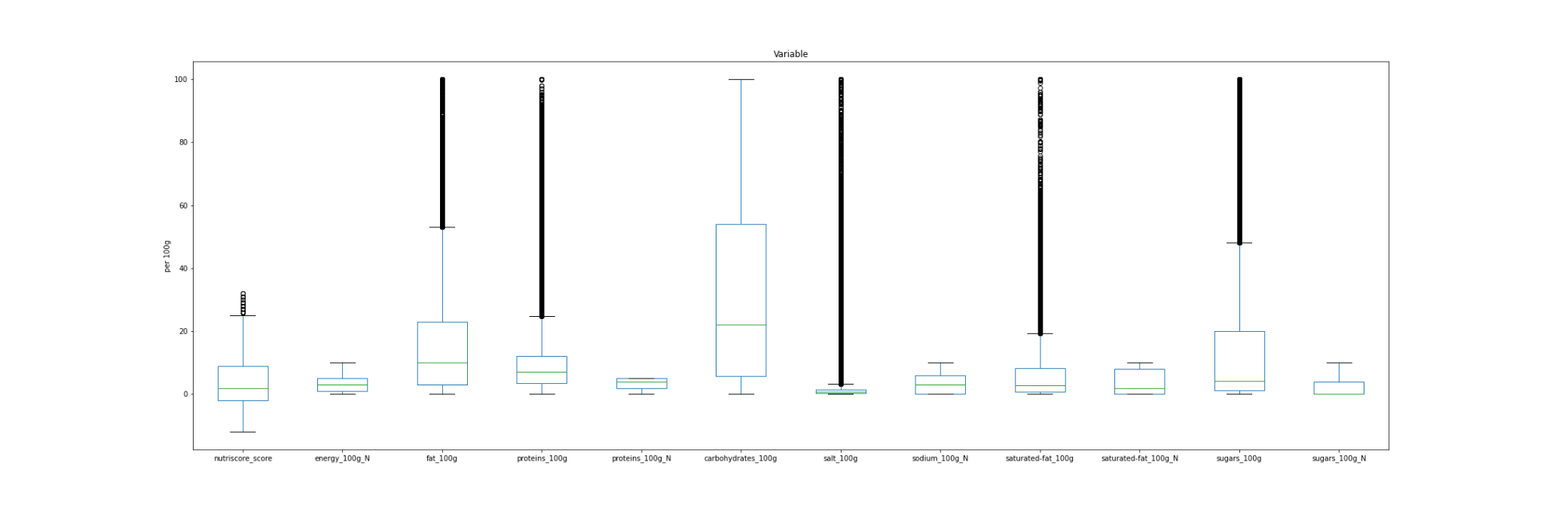
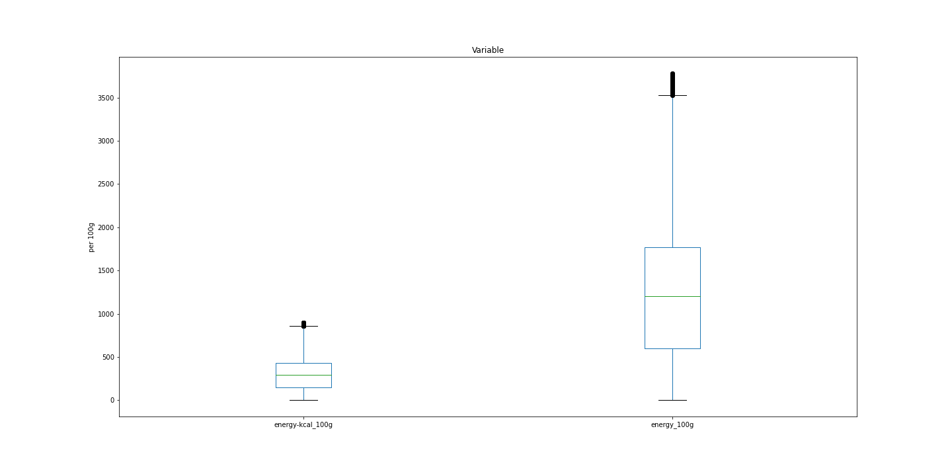
The Spreading of the data after data cleaning
1 .The Distribution of various features using boxplot
2 . Boxplot explains how our data is spead and we can use outliers using this graph
3 . We can explain whether the data is uniformly symmetric in distribution or has left skewness or Right skewness
4. The points above of viscous are called outliers

Slide 24




KNN
01
02
03
04
Finding NAN values
Find the optimal K
Faire un Analyse K pour trouver le meilleur K a utiliser
Feed to the KNN imputer
Import NAN
Fiaire l’operation pour trouver les donner manquante
Utiliser les meme forumle poru remplir le Nutrigrade

Slide 25
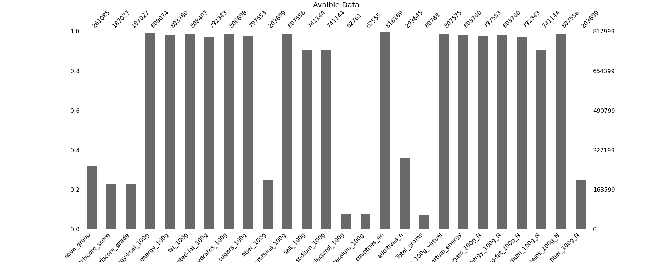
See NAN values
After Cleaning as much as we can without using KNN imputer. We need now to get a big enough NAN free Data set to be able to predict the the Optimal “K” that we will be using on the whole data without any Discrimination.
We are planing to remove the lowest values and that has no effect on the Nutrigrate what’s so ever

Slide 26
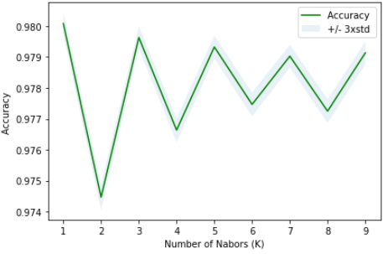
See the Accurracy K
is imputer ,this doesn't have accuracy or performance measures
for majority vote for categorical imputing
genrally thety are float and we represent them as continuous values
for contious ->we take averages values fron n_neiugbors
Imputation des nuscro et nugrade. Jeu donnes finale
Taux de donner manquante

Slide 27
1. How did you import data
2. Describing your data set
2.data cleaning
3. data visualization
4. stats analysis
5. modeling
5. performance

Slide 28
03
Resultats

Slide 29
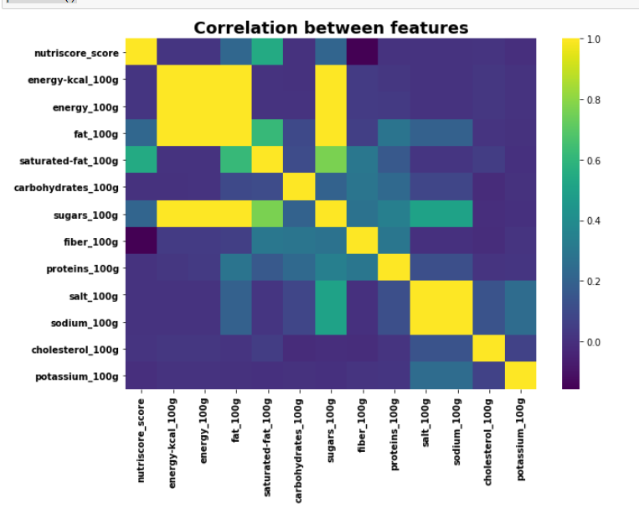
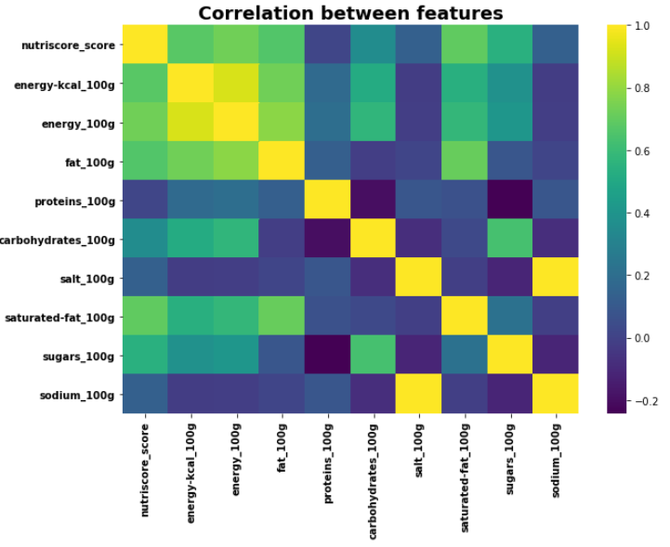
Corrélation des données avant et après nettoyage
What we see
We notice that after cleaning we see a stronger correlation of reason that the badly recorded data and the NANs affect the correlation

Slide 30
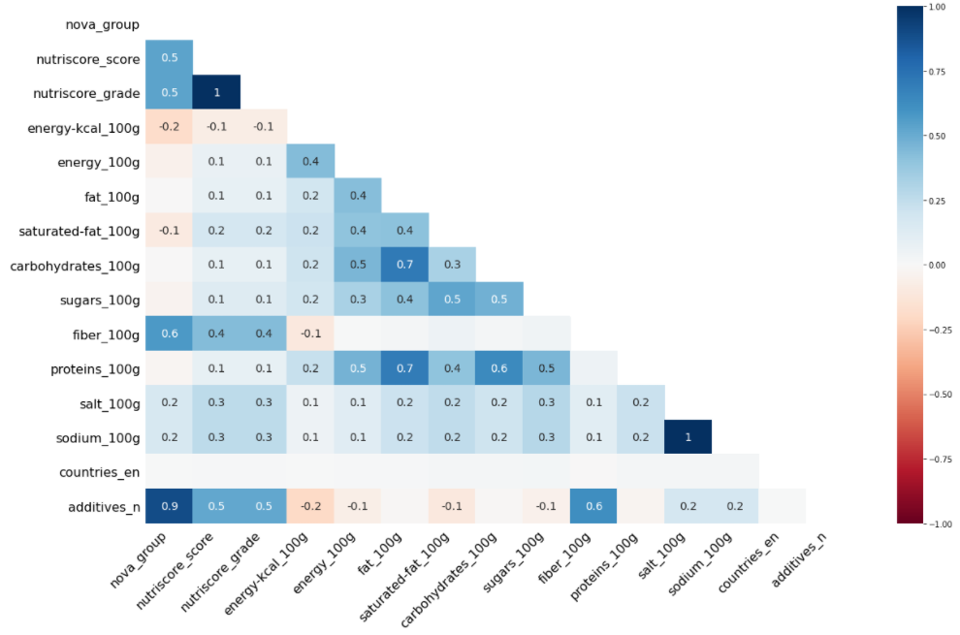

Slide 31
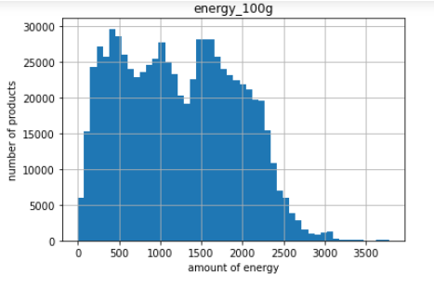
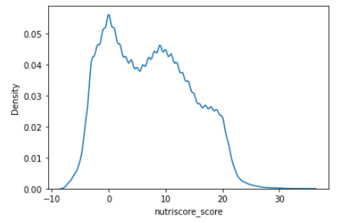
Analyse univariee
Distribution of our data set Bell -curve or Gaussian curve with bimodal right sku

Slide 32
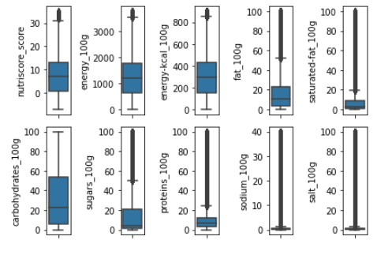
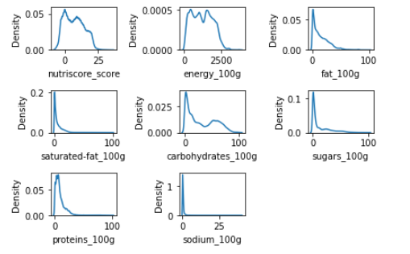
Univariable
Expliquer c’est quoi kdeplot probabilite

Slide 33
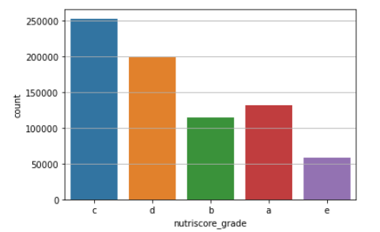
Univariable
Sorting a mettre

Slide 34
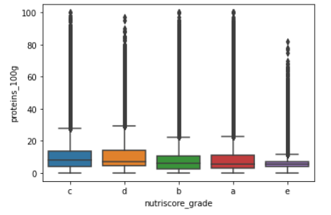
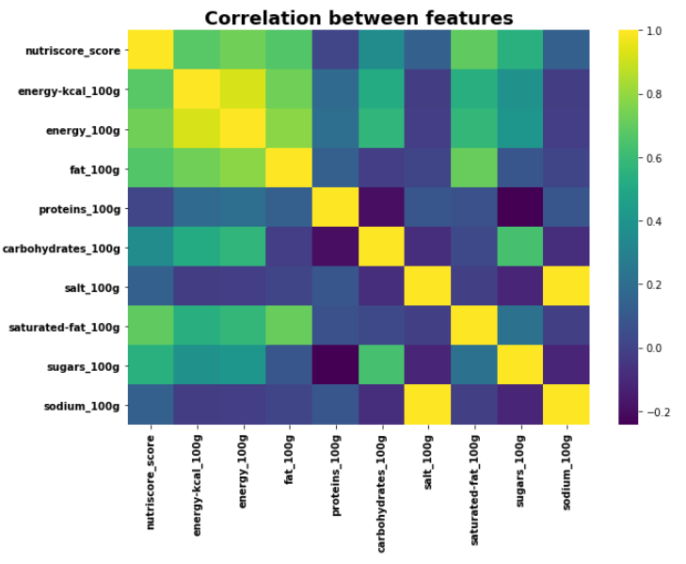
Bi Variable

Slide 35
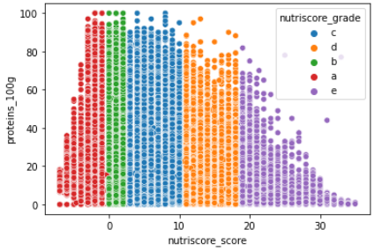
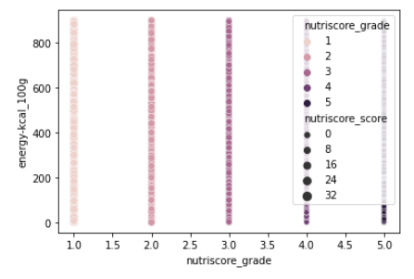
Tri variable

Slide 36
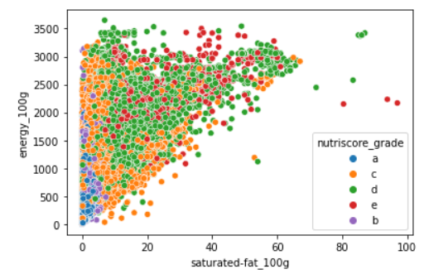
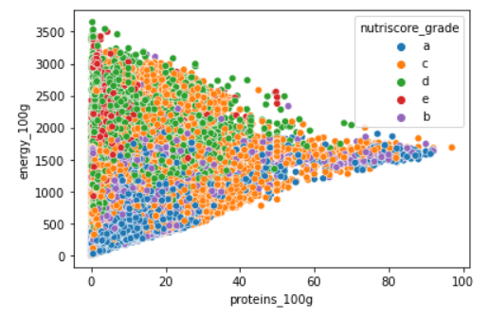
Tri Variable

Slide 37
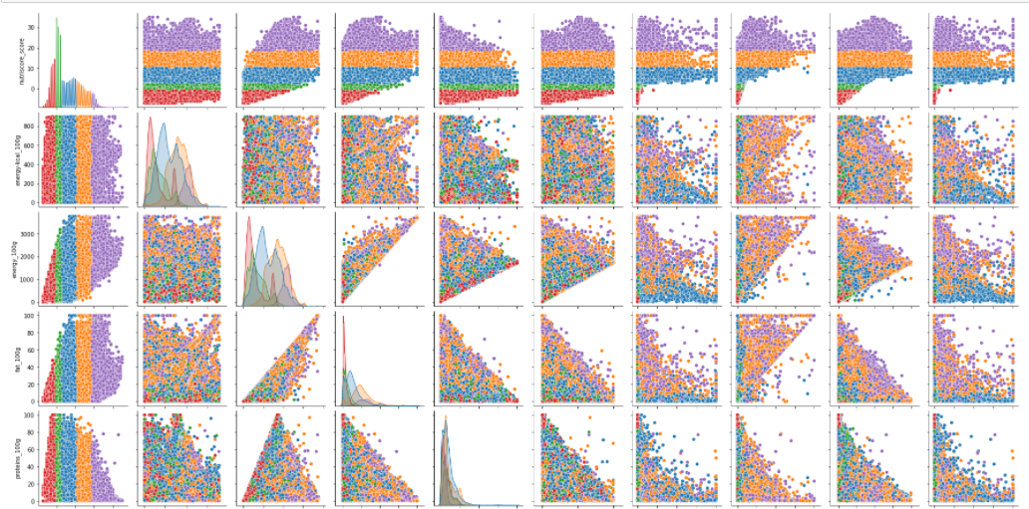
Multivariable

Slide 38
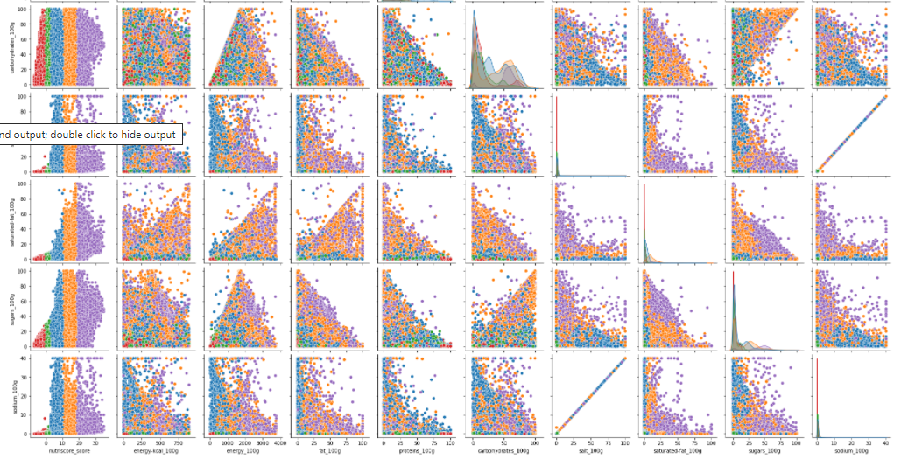
Multivariable

Slide 39
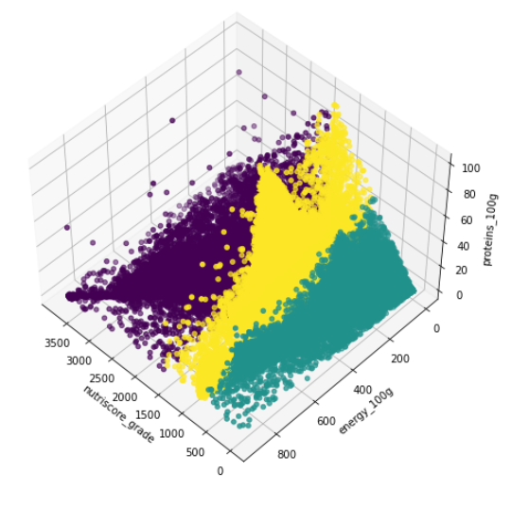

Slide 40
04
statistical test
Analyse Pearson. ANOVA, PCA et Chi2 test

Slide 41
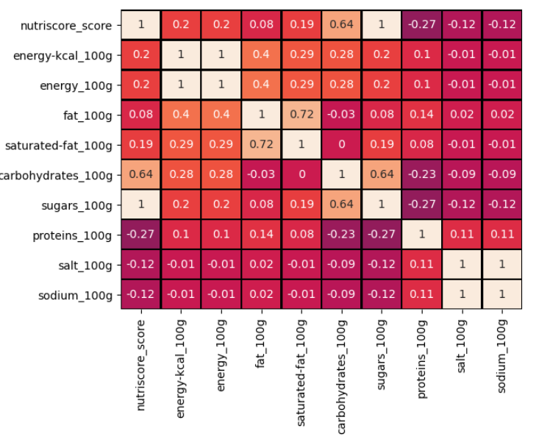





Person

Slide 42
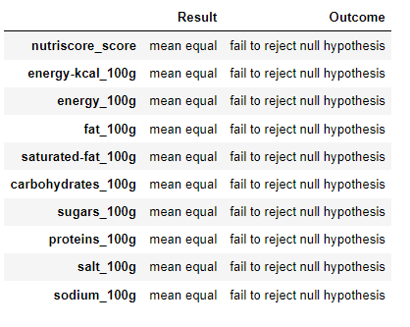
Anova

Slide 43
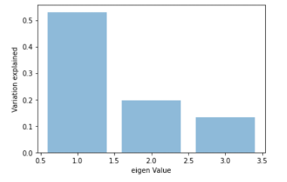
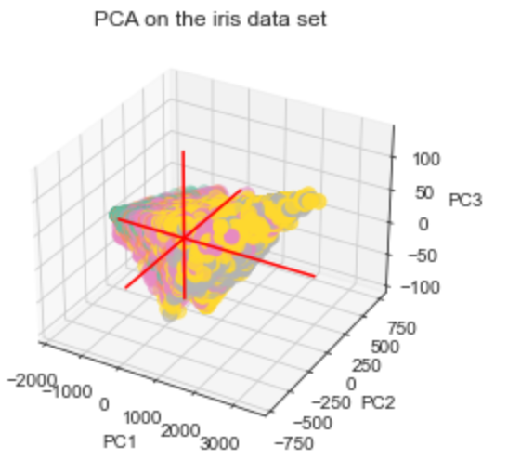
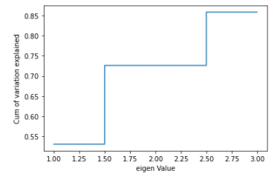
PCA

Slide 44
PCA test
ell PCA, as suggested above by does help you remove features with the least correlation and use mash the features together such that they have the highest correlation.
To answer your question, how to visualize higher dimensions using PCA
Transform the feature matrix with the number of components of your data set to 2 or 3 This ensures you can represent your dataset in 2 or 3 dimensions. To simply see your answer just plot this transformed matrix into a 2d or 3d plot respectively. This helps you visualize a higher dimensionality data as a 2d or 3d entity so while using regression or some predictive modeling technique you can assess the trend of data. Should we use PCA in machine learning algorithms more often?
Well, that strictly depends, using PCA reduces the accuracy of your data set so unless you need to save up some space caused due to a lot of features with bad correlation and the overall accuracy doesn't matter. If your machine learning model scenario is similar to this then it is ok to proceed.
However, most use of PCA is as you asked before for visualizing higher dimensionality data to determine the data trend and to check which model fits best.
It is often the case that to solve a machine learning problem we have to deal with multiple features. Because of this, the learning process can take a long time and sometimes the solution is not acceptable. This is the curse of dimensionality. To deal with the above problems sometimes it is enough to reduce the number of features. But by reducing dimensionality we lose some information. Therefore, we should get rid of the information that does not interfere with the model. Sometimes we can remove noise and irrelevant details, so a model will achieve better results on a test set. When two independent variables interact very strongly, i.e., the correlation coefficient is close to 1 or -1, we provide the algorithm with the same information in two dimensions, which is redundancy. It is an unnecessary increase in dimensionality.

Slide 45
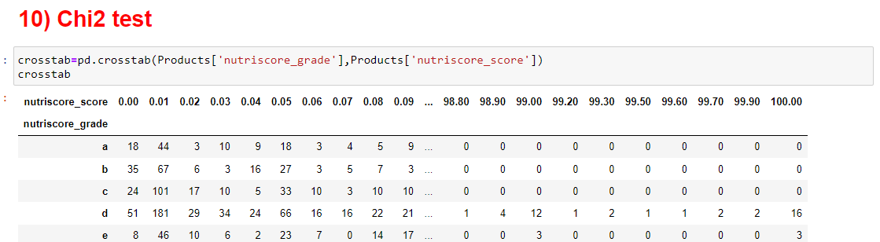
Chi2 test
Open food facts nova entre le nutri score et et le Nutri grade. Nova a part , faire ca en graphique quantingence

Slide 46
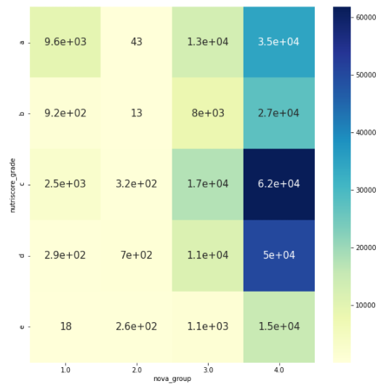
WHY Chi2 test
Chi-square test is a very well know and famous test that is used to determine whether there is a statistically significant difference between the expected frequencies and the observed frequencies in one or more categories of categorical variables. In machine learning, the Chi-square test can be used to check the association of variables among categorical variables. Based on the test results we can eliminate those variables which are not strongly associated with the response variable. Alternatively, we can also check the association of independent variables among themselves and can drop those variables which are strongly associated with each other. The concept is the same as Pearson’s correlation coefficient test, but the difference is quite evident.
Correlation vs Chi-square test
Pearson’s correlation coefficient is used to illustrate the relationship between two continuous variables, such as years of education completed and income. The Chi-square test of Independence determines whether there is an association between two categorical variables i.e. whether the variables are independent or related like for example if education level and marital status are related for all people in some country.

Slide 47
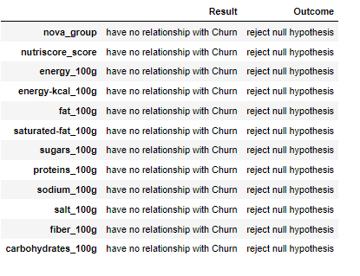
Result
sns.set_style("whitegrid")
sns.FacetGrid(iris, hue="species", size=4) \
.map(plt.scatter, "sepal_length", "sepal_width") \
.add_legend()
plt.show()
sns.set_style("whitegrid");
sns.pairplot(iris, hue="species", size=3);
plt.show()

Slide 48
05
KNAP SACK
Creation du platform Knapsack

Slide 49
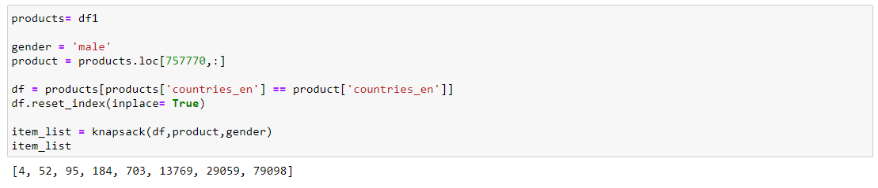
Knapsack
The knapsack problem is a problem in combinatorial optimization: Given a set of items, each with a weight and a value, determine the number of each item to include in a collection so that the total weight is less than or equal to a given limit and the total value is as large as possible.
I have combined several code to my Knapsack formula to create my option
The platform will analy the gender, the county the intake ( Calories, Protein, Sugar , fat ) and the product the person is interested to eat on this day.
Then it will find the optimal combination of products he would be able to eat during the day.

Slide 50
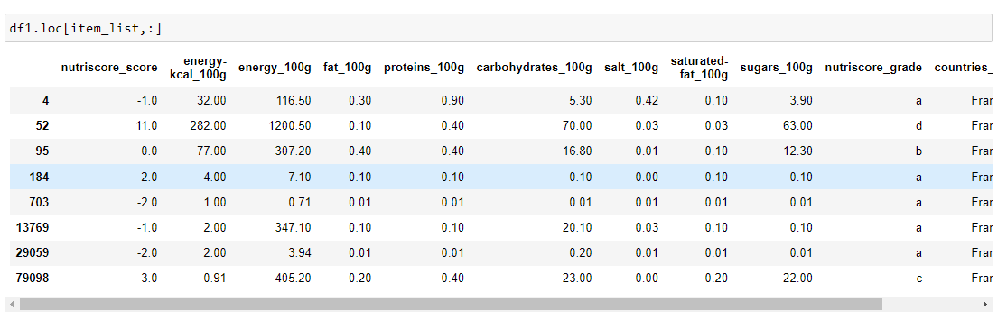
Knapsack

Slide 51
04
.Py Programing

Slide 52

Thank You

